Slide 1
SysML tooling for design and engineering of System of Systems
Prof. Jerker Delsing
Luleå University of Technology
Sweden

Slide 2
What is SysML
The Systems Modeling Language (SysML)^{[1]} is a general-purpose modeling language for systems engineering applications. It supports the specification, analysis, design, verification and validation of a broad range of systems and systems-of-systems.
SysML was originally developed by an open source specification project, and includes an open source license for distribution and use.^{[2]} SysML is defined as an extension of a subset of the Unified Modeling Language (UML) using UML's profile mechanism. The language's extensions were designed to support systems engineering activities.

Slide 3
SysML Tools
MagicDraw - Cameo, commercial
SysML v1.6
Extensive graphical system modelling tool based on SysML
Papyrus - Eclipse Open source
SysML 1.6 and upcoming v2.0

Slide 4
System of Systems modelling
Based on
Service Oriented Architecture
Micro-system producing and consuming micro-services

Slide 5
SOA/microsystem characteristics
Look up
Requires a service registry
Late binding
Requires orchestration capability
Loose coupling
Autonomous exchange of services, push or pull based
A micro system performs its function independently
A micro system can
be stateful and is then responsible for and stores its own state
be stateless
A micro system produces and/or consumes one or several services

Slide 6
SoS characteristics
Operational independence/autonomy of the elements. The constituent systems can operate independently in a meaningful way, and are useful in their own right.
Belonging. The autonomous constituent systems choose to belong to the SoS, and they do that because they see a value for themselves to give up some of the autonomy in order to get benefits from doing so.
Connectivity. To let the constituent systems interact, they must be connected, and unless they provide sufficiently generic interfaces, they need to be modified to provide such interoperability. Connectivity in an SoS is thus dynamic, with interfaces and links forming and vanishing as the need arises.
Diversity - heterogeneity. Whereas many other systems strive to minimize diversity to simplify the system, an increased diversity in an SoS gives it the ability to better deal with unforeseen situations during its life cycle.
Managerial independence of the elements. The constituent systems not only can operate independently, but they do operate independently even while being part of the SoS. They are acquired separately.
Evolutionary development. The SoS does not appear fully formed, and functions and purposes are added based on experience.
Emergent behavior. The principle purposes of the SoS are fulfilled by behaviors that cannot be localized to any individual constituent system. In an SoS, the emergent behavior is not restricted to what can be foreseen. Instead, it should have the capability to early detect and eliminate bad behavior that emerges.
Geographical distribution. The constituent systems only exchange information and not substantial quantities of mass or energy.
Secure and safe. Malicious behaviors in a SoS and its constituent systems need to be detected and mitigated to ensure information, system and SoS integrity.

Slide 7
Modelling of System of Systems, SoS
Based on Eclipse Arrowhead
A SOA/microsystem framework for creating automation and digitalisation solutions based on SoS

Slide 8
SysML modelling basics
Requirement diagram/table
Use case diagrams
Activity diagram
Block definition diagrams
Internal block diagrams
Parametric diagram
State machine diagram
Sequence diagrams
…
…

Slide 9
SOA support
Profile
Based on Eclipse Arrowhead
Intend to support several engineering phases for a solution
Requirement
Design conceptual, black box,
Design of implementation, white box,
Procurement & Engineering
Deployment

Slide 10
SOA support, cont
Library
Eclipse Arrowhead core systems
Templates for
Local clouds
System of Local clouds
Generic application systems
Devices
Network

Slide 11
Engineering tools
<<system>>
TestTool
<<system>>
SandboxingTool
<<system>>
LegacyIntegration
<<system>>
ConsumerCodeGen
<<system>>
Eclipse-Vorto
<<system>>
SysML 1.6 profile
<<system>>
SysML 2 profile
<<system>>
Installation
<<system>>
CI/CD pipeline
<<system>>
Python lib
<<system>>
Kalix lib (Java)
<<system>>
Evopro lib C++)
<<system>>
Eng process
<<system>>
Tool chain interoperability
Management support:
<<system>>
ManagementTool
<<system>>
SafetyManager
<<system>>
SecurityManager
<<system>>
Eclipse-Ditto
<<system>>
Training material
Supply chain/product life cycle
<<system>>
Contract Proxy
Released
Execution support
<<system>>
WorkflowManager
<<system>>
WorkflowExecutor
<<system>>
Choreography
<<system>>
WSO2+CPN
<<system>>
OrchestrationMitigation
Release candidates
Control support
<<system>>
ControlStrategy
Arrowhead v4.3.0
Prototypes
System of Systems support
<<system>>
PlantDescription
<<system>>
Configuration
<<system>>
SecurityMitigation
<<system>>
QoS
<<system>>
Eclipse-Hono
Separately released
<<system>>
EventHandler
<<system>>
DataManger
<<system>>
Eclipse-hawkBit
<<system>>
Eclipse-Kura
<<system>>
Eclipse-Kapua
Inter cloud service exchange
<<system>>
Gatekeeper
<<system>>
Gateway
Interoperability
<<system>>
Translation
<<system>>
Semantics
<<system>>
61499
<<system>>
FiWare
<<system>>
OPC-UA
<<system>>
BaSyx
<<system>>
ModbusTCP
<<system>>
ROS
Secure infrastructure:
<<system>>
SystemRegistry
<<system>>
DeviceRegistry
<<system>>
On-boarding
<<system>>
SecurityCompliance
<<system>>
Eclipse-Keycloack
Local cloud basic properties:
<<system>>
ServiceRegistry
<<system>>
Authorisation
<<system>>
Orchestration
<<system>>
CertificateAuthority

Slide 12
Engineering tools
<<system>>
SysML 1.6 profile
<<system>>
SysML 2 profile
<<system>>
Kalix lib (Java)
<<system>>
Eng process
<<system>>
Python lib
<<system>>
Evopro lib C++)
<<system>>
Eng process
Management support:
Supply chain/product life cycle
Released
Execution support
Release candidates
Control support
Arrowhead v4.3.0
Prototypes
System of Systems support
<<system>>
QoS
Separately released
<<system>>
EventHandler
<<system>>
DataManger
Inter cloud service exchange
<<system>>
Gatekeeper
<<system>>
Gateway
Interoperability
<<system>>
Translation
<<system>>
FiWare
<<system>>
OPC-UA
<<system>>
ModbusTCP
<<system>>
ROS
Secure infrastructure:
<<system>>
SystemRegistry
<<system>>
DeviceRegistry
<<system>>
On-boarding
Local cloud basic properties:
<<system>>
ServiceRegistry
<<system>>
Authorisation
<<system>>
Orchestration
<<system>>
CertificateAuthority

Slide 13
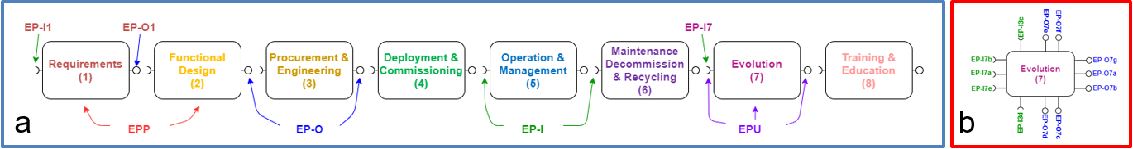
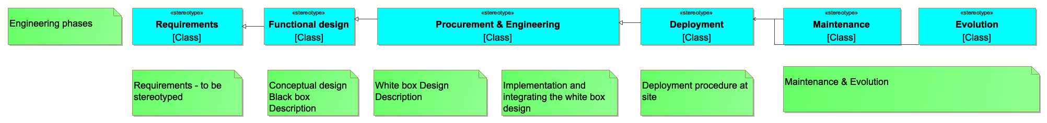
Engineering process

Slide 14
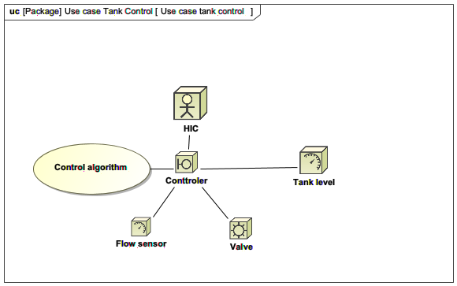


Eclipse Arrowhead engineering
Engineering process
IEC 81346
SoS Requirements
Functional,
non-functional,
security,
commissioning,
operations,
management,
maintenance,
evolution
SoLCD
Functional design - black box
Plant architecture and design,
Functionality design
Security design
Local cloud sectioning
Core system usage,
Application system design,
SoLCDD, LCD,
SysD, SD
Procurement of:
Application hardware, OS, Router,
Installing OS
White box engineering of:
Application systems and services code
Orchestration and security policys
Installing core and application systems to procured HW
Configuration of network,
LCDD, SysDD, IDD
Deployment of:
HW with core and application systems in plant,
Orchestration policys
Security policys
Commissioning of:
Local cloud functionality
System of local cloud functionality
Devices and
network
Physical deployment at site
Devices
Routers
Power supply
Network connection
OS
Core system
selection
Orchestration
Authorisation
Network
Application system & service design
Application
Application
Application
Application system
Application
Service

Slide 15
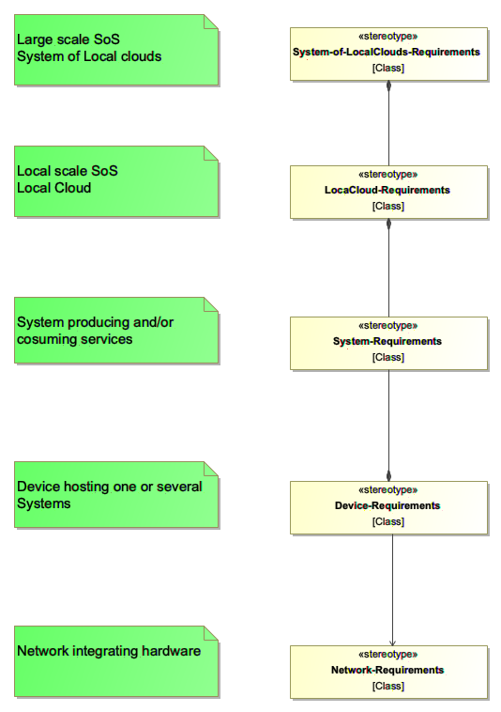
Architecture

Slide 16
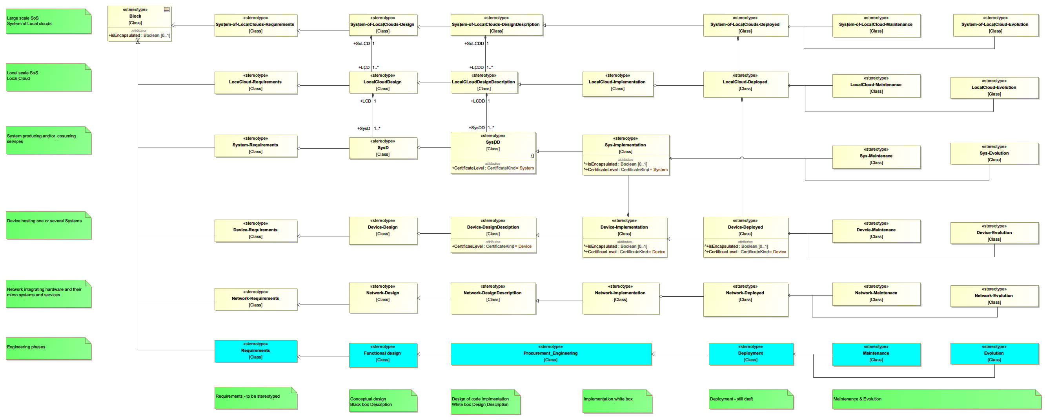
SoS architecture and engineering in SysML

Slide 17
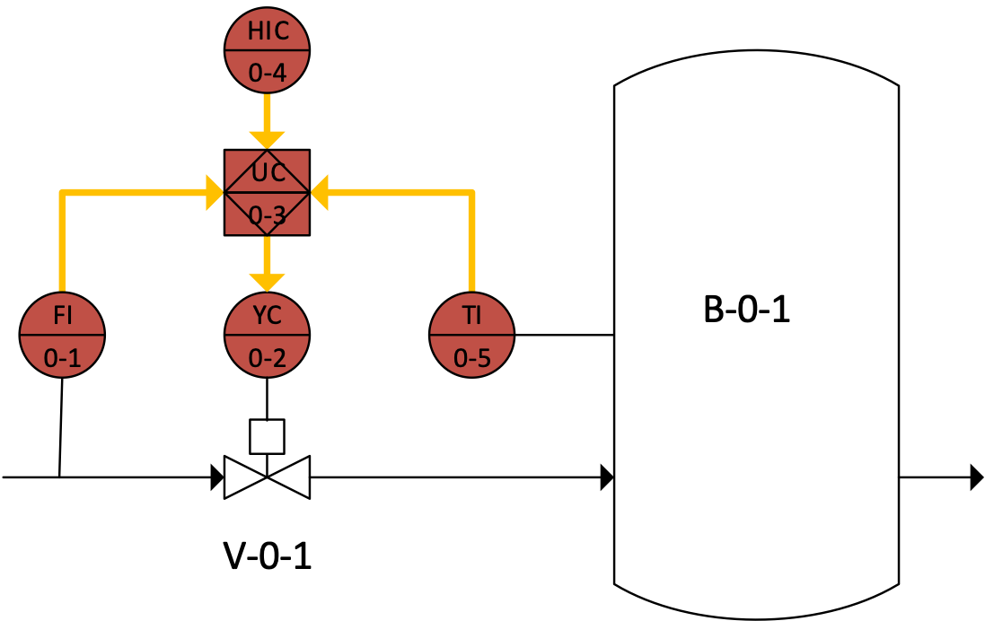
Lets start with a use case

Slide 18
Use case diagram

Slide 19
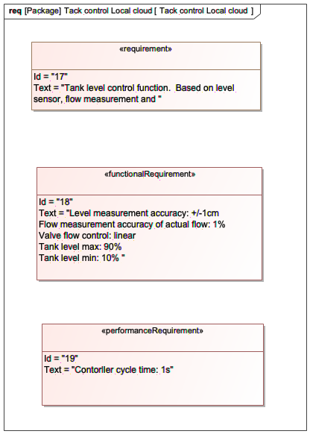
Requirements

Slide 20
SoS architecture and engineering in SysML

Slide 21
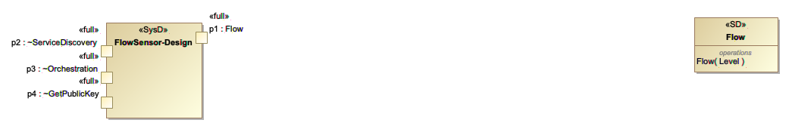
Functional system and service design
Micro-systems
Micro-services

Slide 22
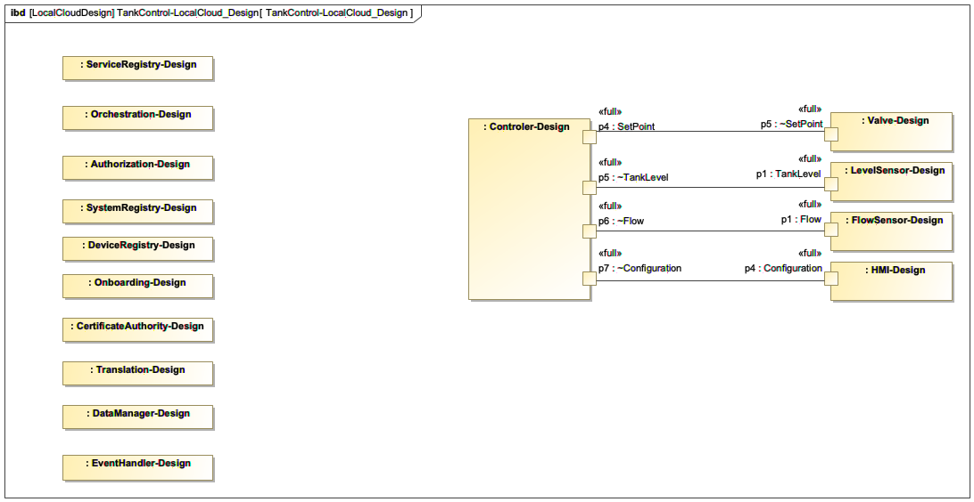
Functional SoS design - black box
Local cloud functional orchestration

Slide 23
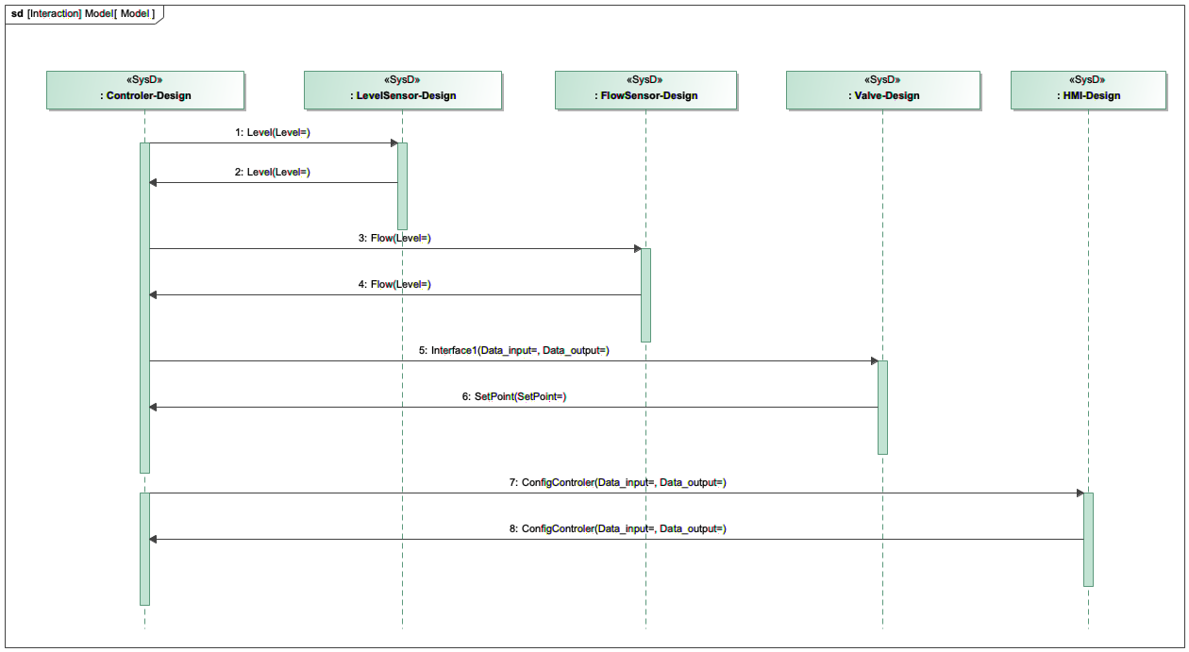
Service exchange functionality

Slide 24
SoS architecture and engineering in SysML

Slide 25
White box engineering
SysDD and IDD

Slide 26
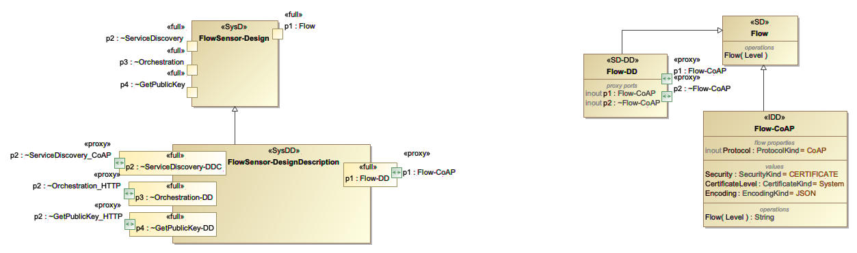
Functional system and service design & design description/implementation
black box & white box + code
Micro-systems
Micro-services

Slide 27
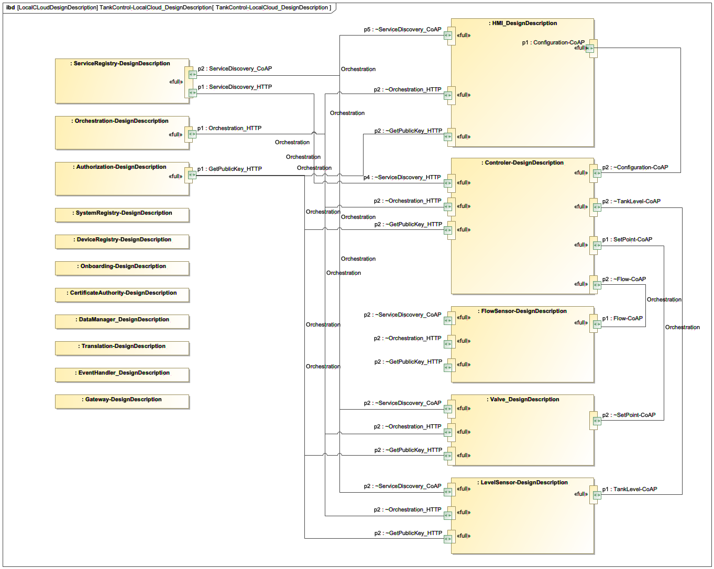
Functional LC design description - white box
Local cloud functional design description model

Slide 28
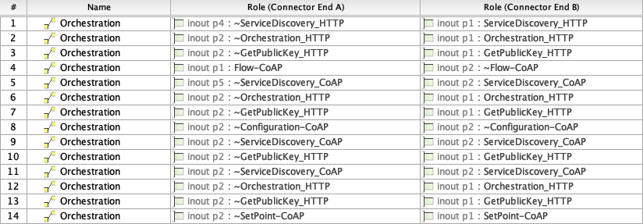
Orchestration policys - rules and conditions

Slide 29
Security policys - rules and conditions

Slide 30
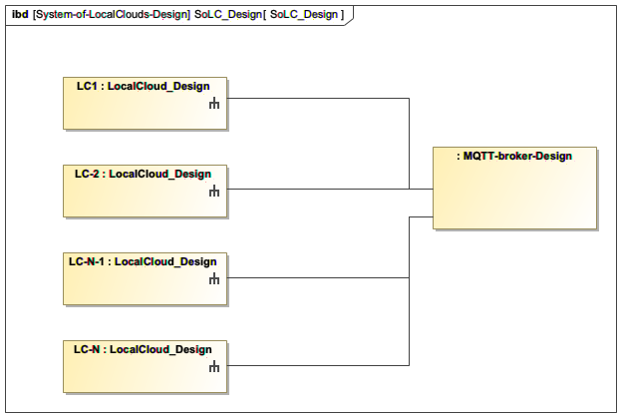
Functional SoLC design
System o local clouds functional design model

Slide 31
SoS architecture and engineering in SysML

Slide 32
Implementation
We also need
Devices
Network

Slide 33
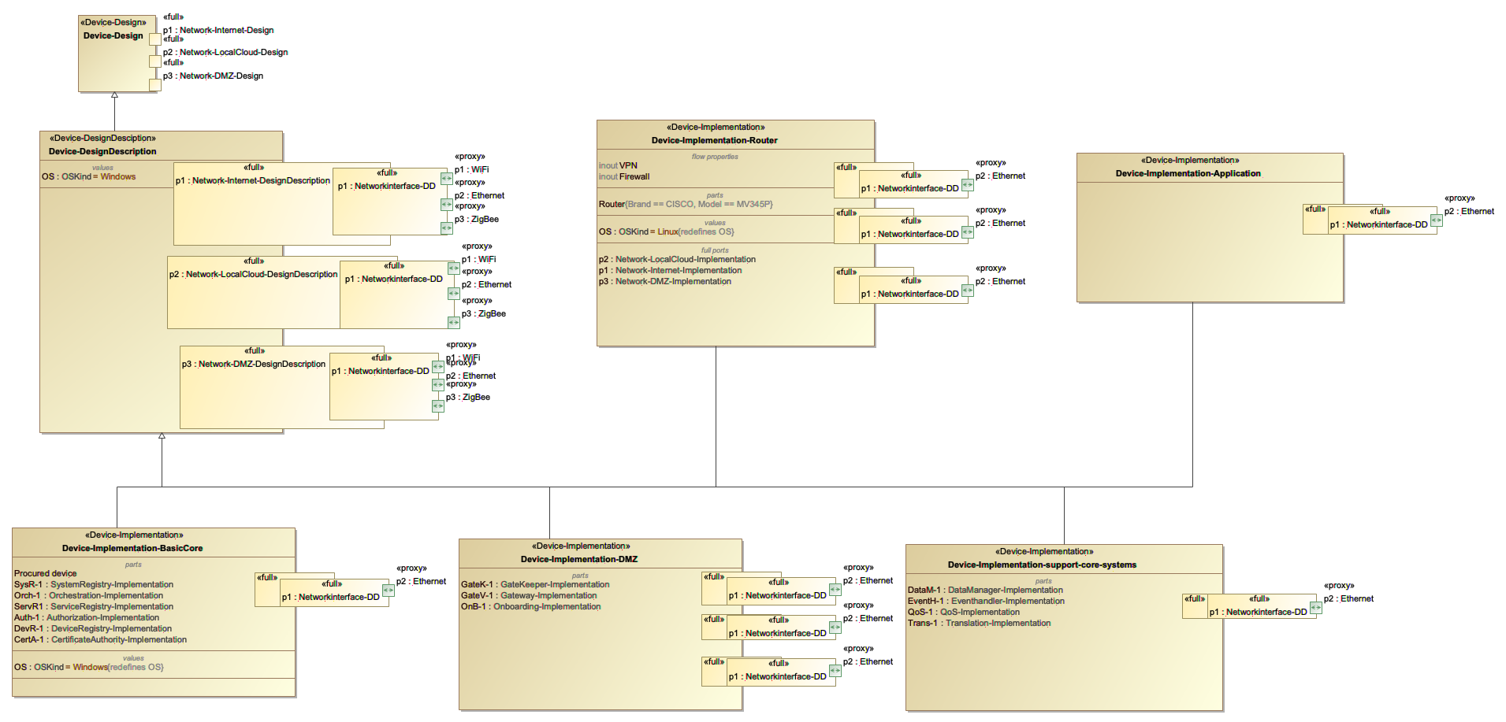
Device implementation
Devices with
Mandatory core systems
Support core systems
Application systems
Router

Slide 34
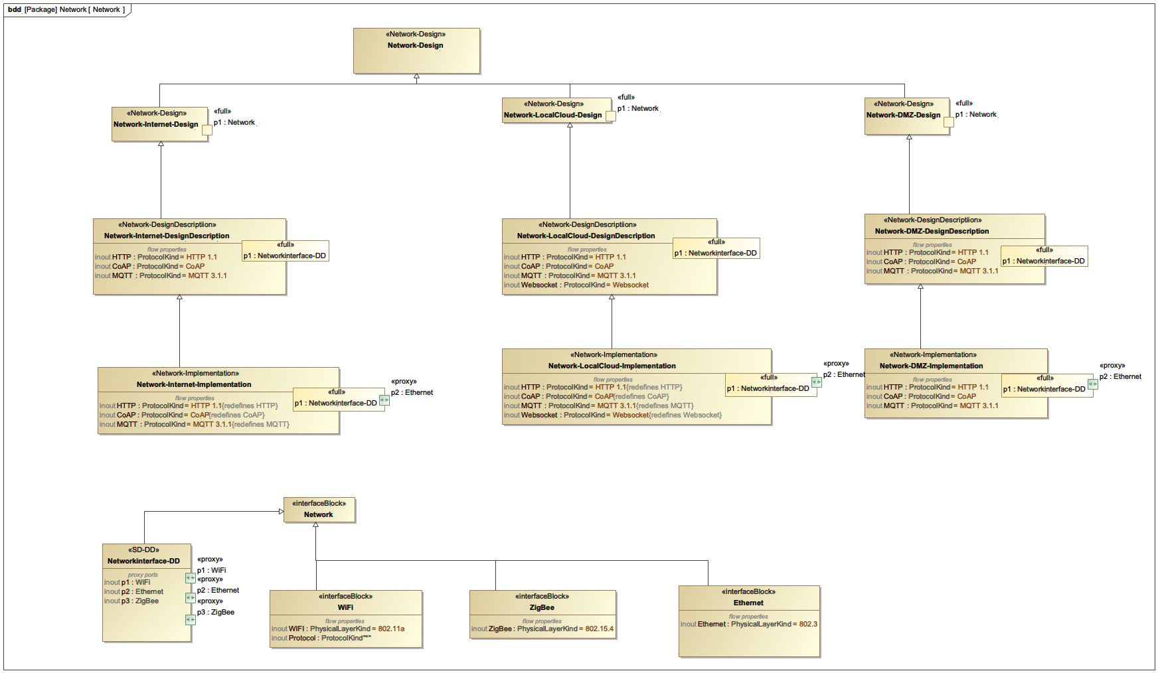
Network

Slide 35
SoS architecture and engineering in SysML

Slide 36
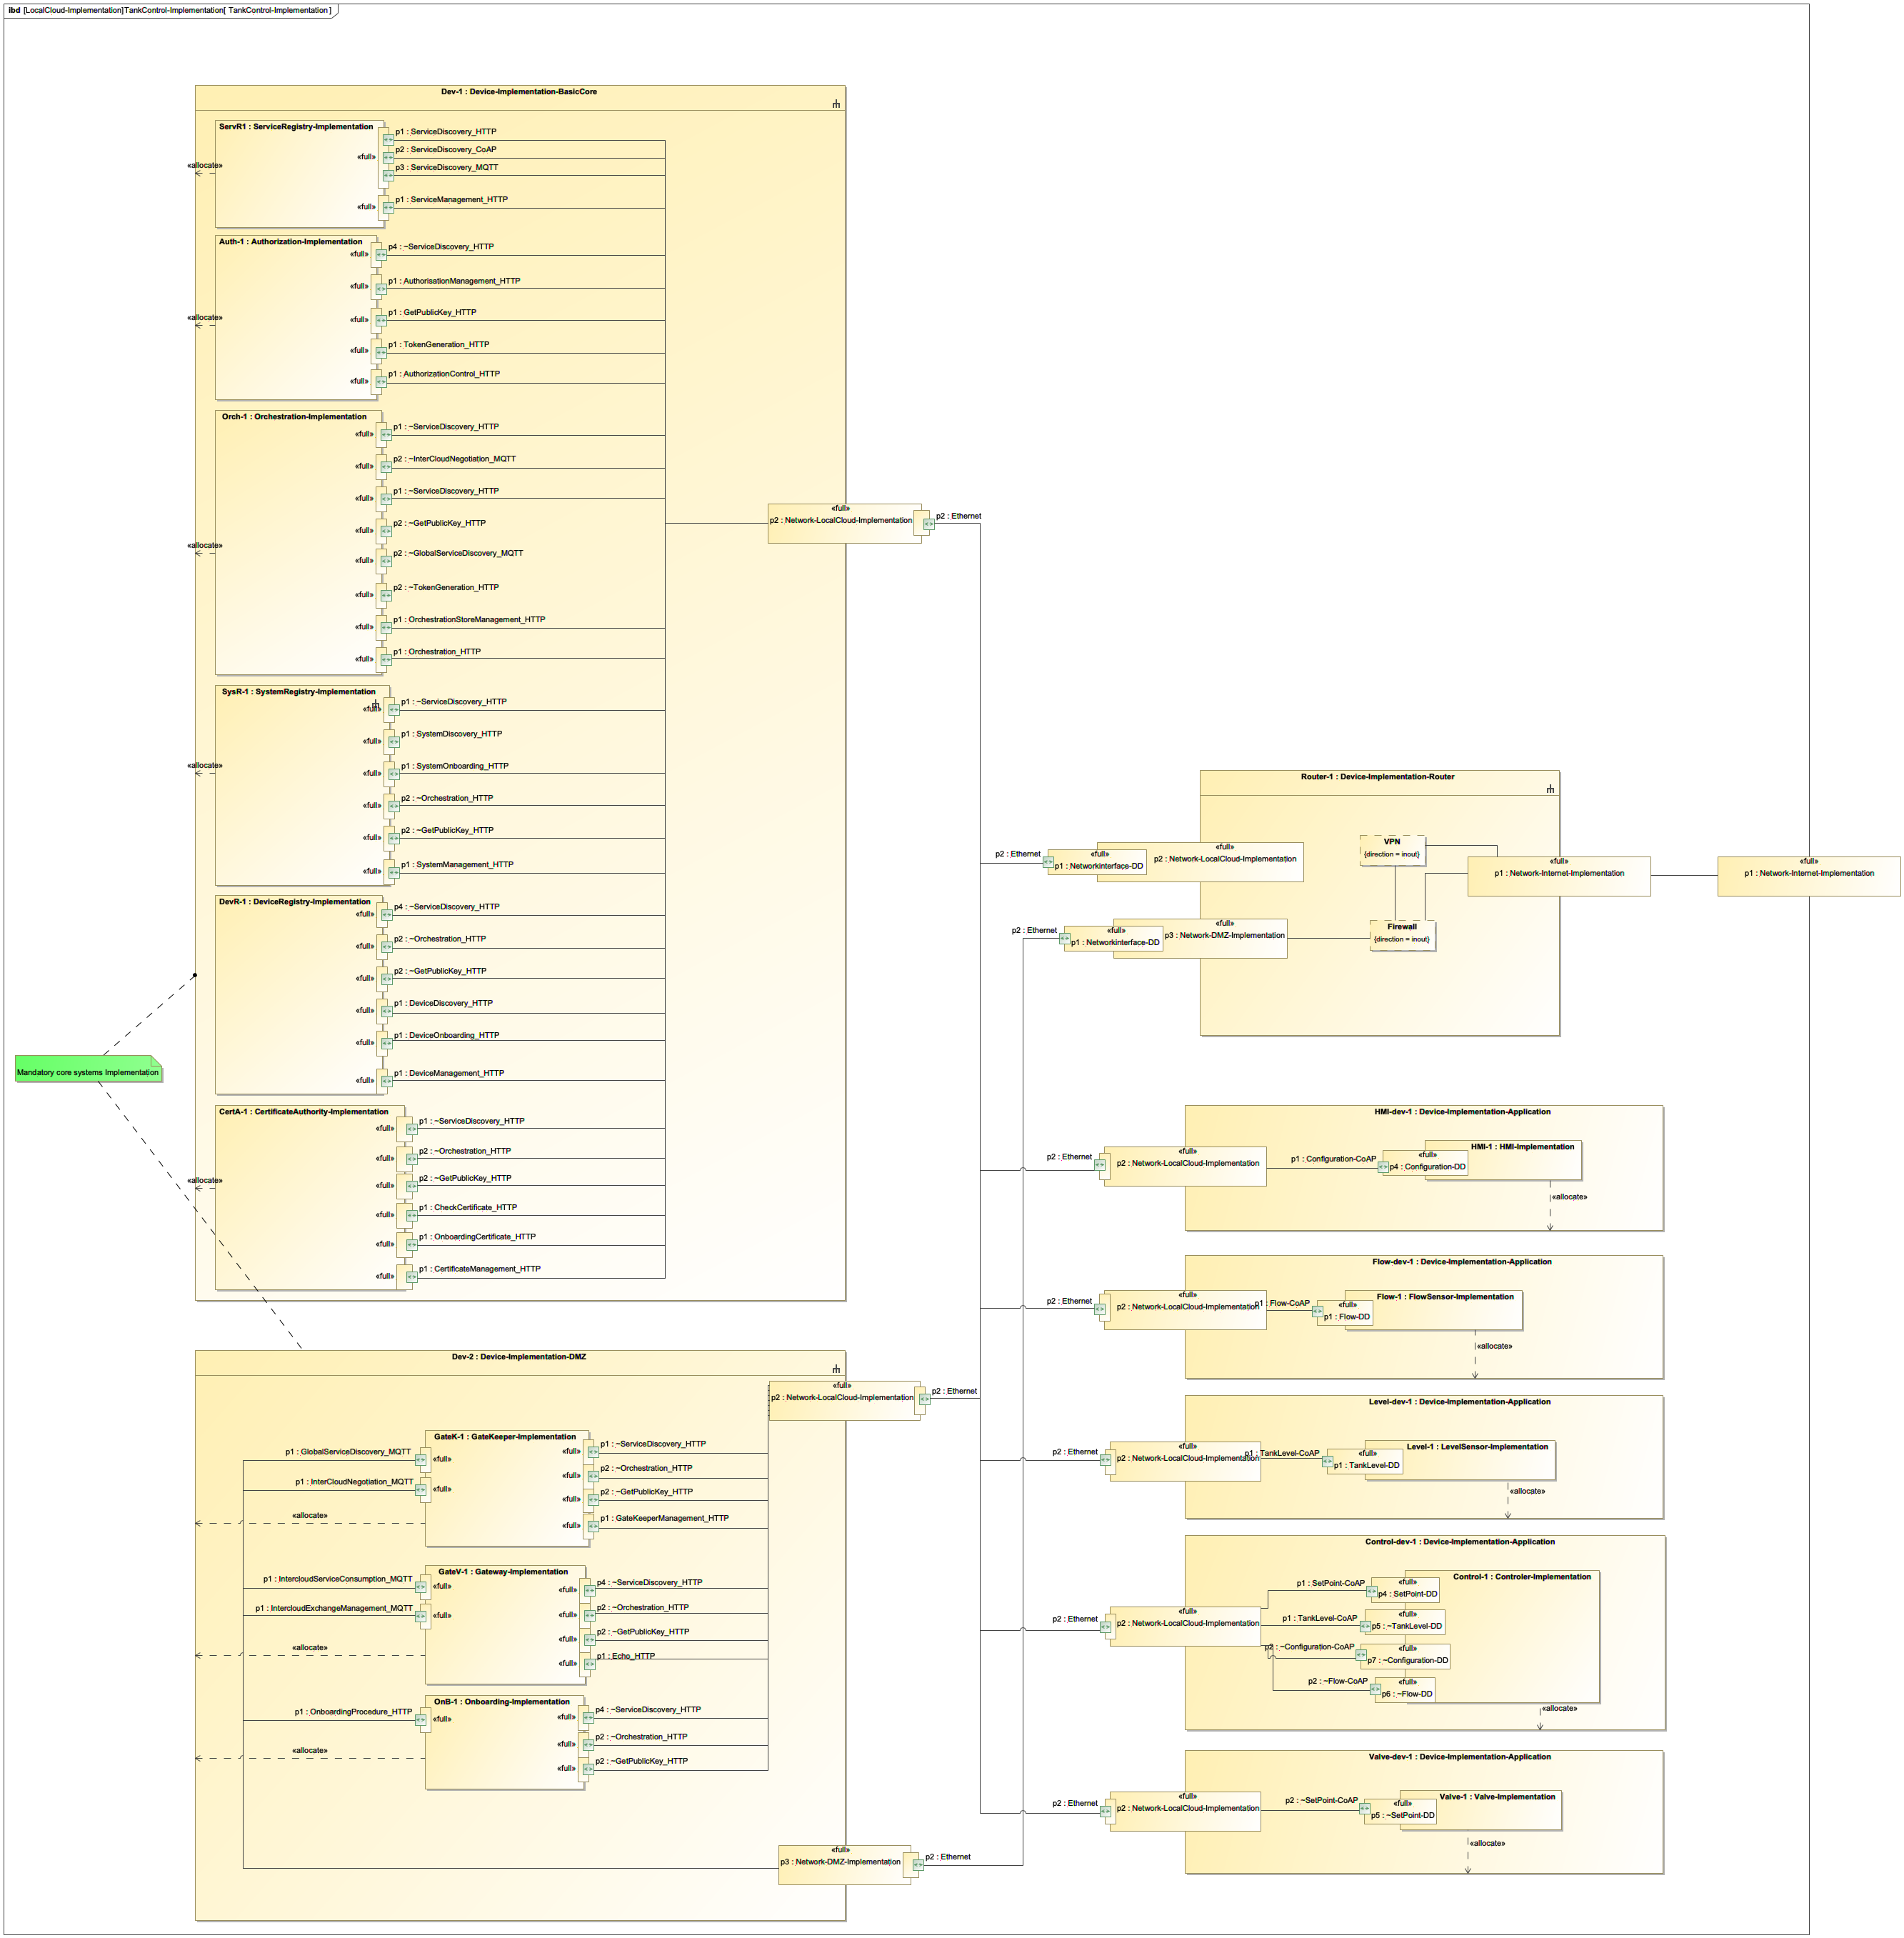
Functional SoS/Local cloud implementation engineering

Slide 37
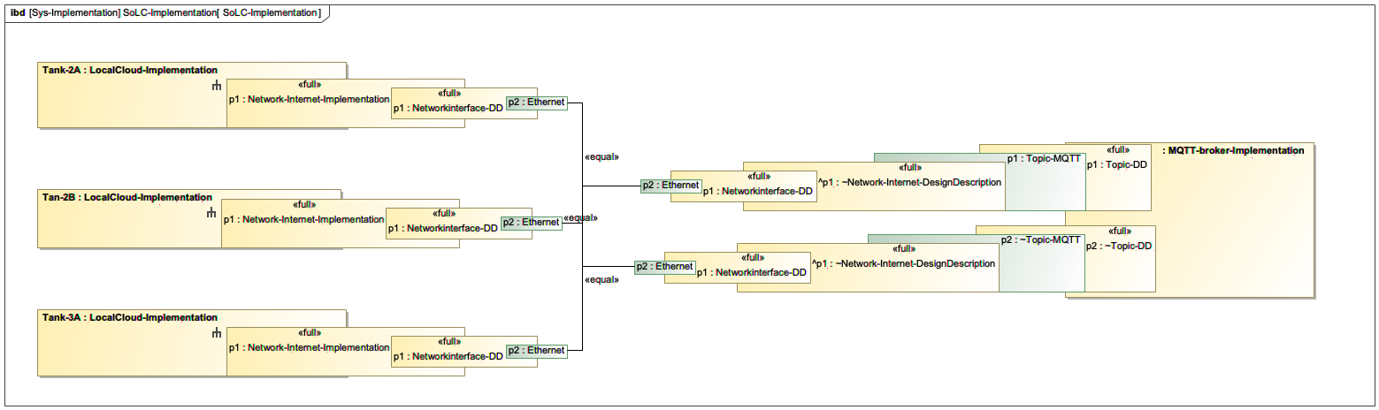
Functional SoLC implementation engineering
System o local clouds functional implementation model

Slide 38
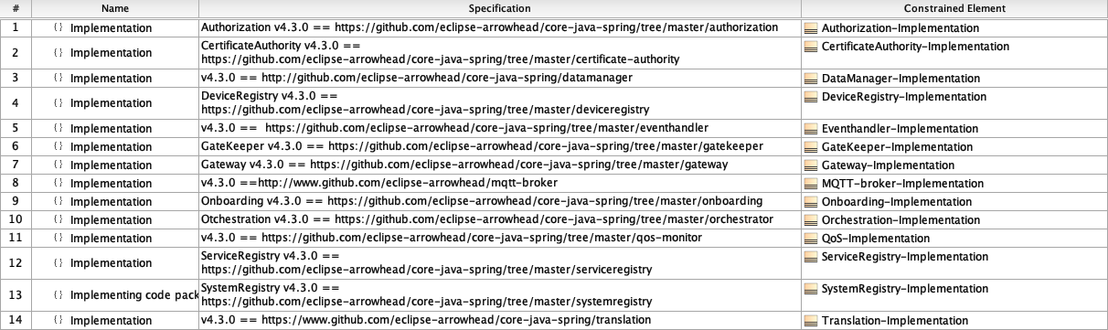
Extraction of code
Move from here to Docker containers for deployment to
Selected HW and OS
Server - Linux - Ubuntu 20.10
Desktop computer, Windows 10.xx, OSX 11.2.1
Embedded system
Raspberry PI

Slide 39
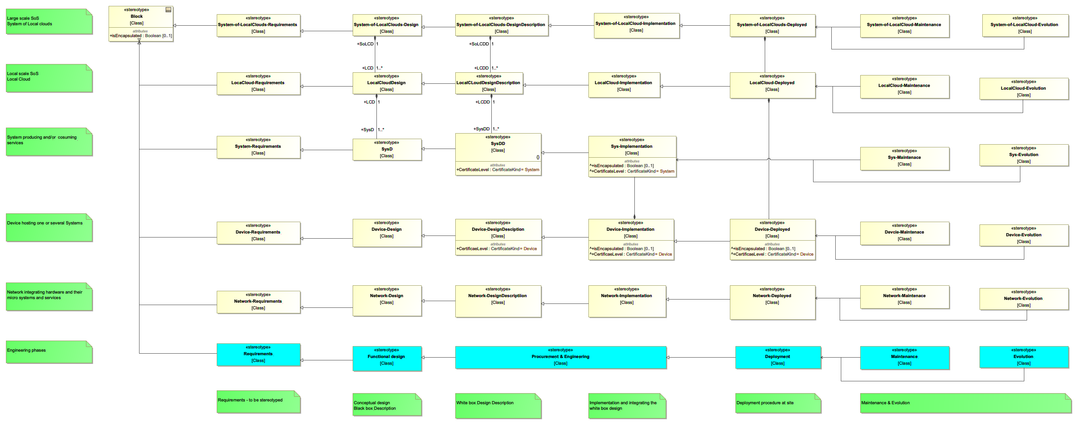
SoS architecture and engineering in SysML

Slide 40
Deployment engineering

Slide 41
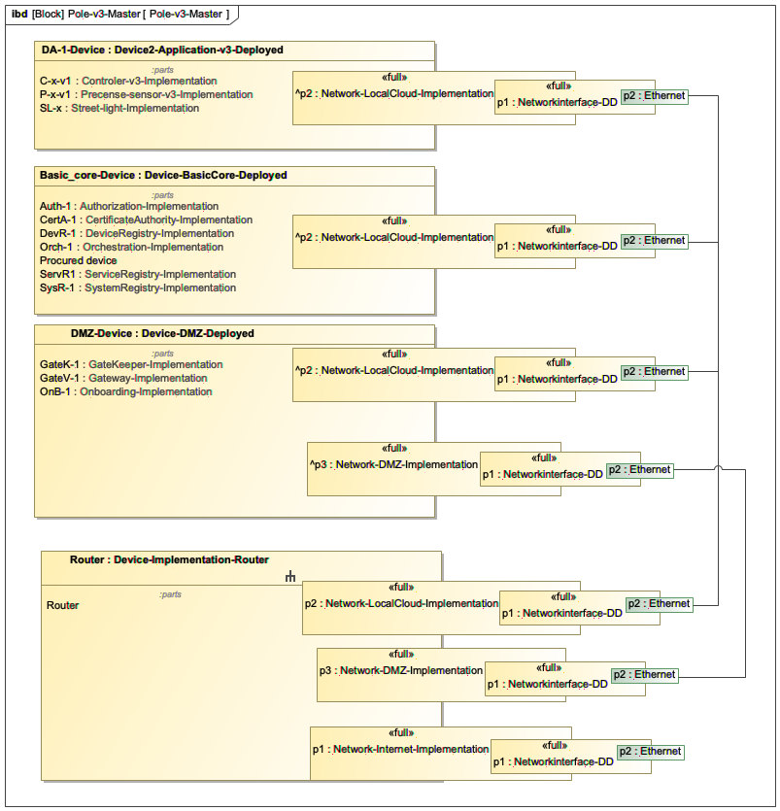
SoS/Local cloud implementation engineering
-
Resulting solution ready to deploy and operate

Slide 42
SoS/Local cloud implementation engineering

Slide 43
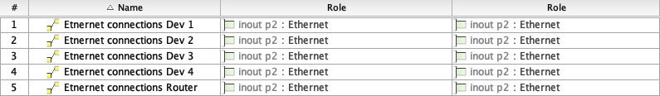
Network deployment
ToDos
ID of instances to be made according to standards
Automatic naming of instances based of standards
Applicable standards
ISO 15926
ISO 10303
ISO 19650 - BIM v5

Slide 44
Deployment of policys
Orchestration policys
PlantDescription system
Management system
Authorisation rules
PlantDescription system
Management system
}
Orchestration system
}
Authorisation system

Slide 45
SoS architecture and engineering in SysML

Slide 46
Availability
Github
https://github.com/jerkerdelsing/SysML_profile_library
will move to GitHub.com/eclipse-arrowhead
soon
Owncloud
https://atmospheres.research.ltu.se/owncloud/index.php/apps/files/?dir=/Arrowhead_Tools/WP3%20Arrowhead%20Framework/Task%203.1/Work/SysML_Arrowhead_profile/Profile/JD/Distribution/SysML_profile_library&fileid=1940133

Slide 47
Next step
Move from here to Docker containers for deployment to
Selected HW and OS
Server
HP …, Linux - Ubuntu 20.10
Desktop computer,
Dell…, Windows 10.xx,
MacBookPro, OSX 11.2.1
Embedded system e.g.
Raspberry PI, Ubuntu PI4

Slide 48
Next step
Models of support core systems to be releases
Models of adaptor systems
OPC-UA -> Arrowhead - Aparajita, An
Modbus TCP -> Arrowhead, TWT
Z-wave -> Salman
Models of libraries
Python - Jacob
Kalix - Emanuel
C++ - Szvetlin

Slide 49
Next step
Modelling of other systems
I need documentation
SysD
SD
IDD
code pointer
package pointer is good
You get
Feedback on documentation
Possibilities to validated your results in a larger environment
Enables your results to be used by others

Slide 50
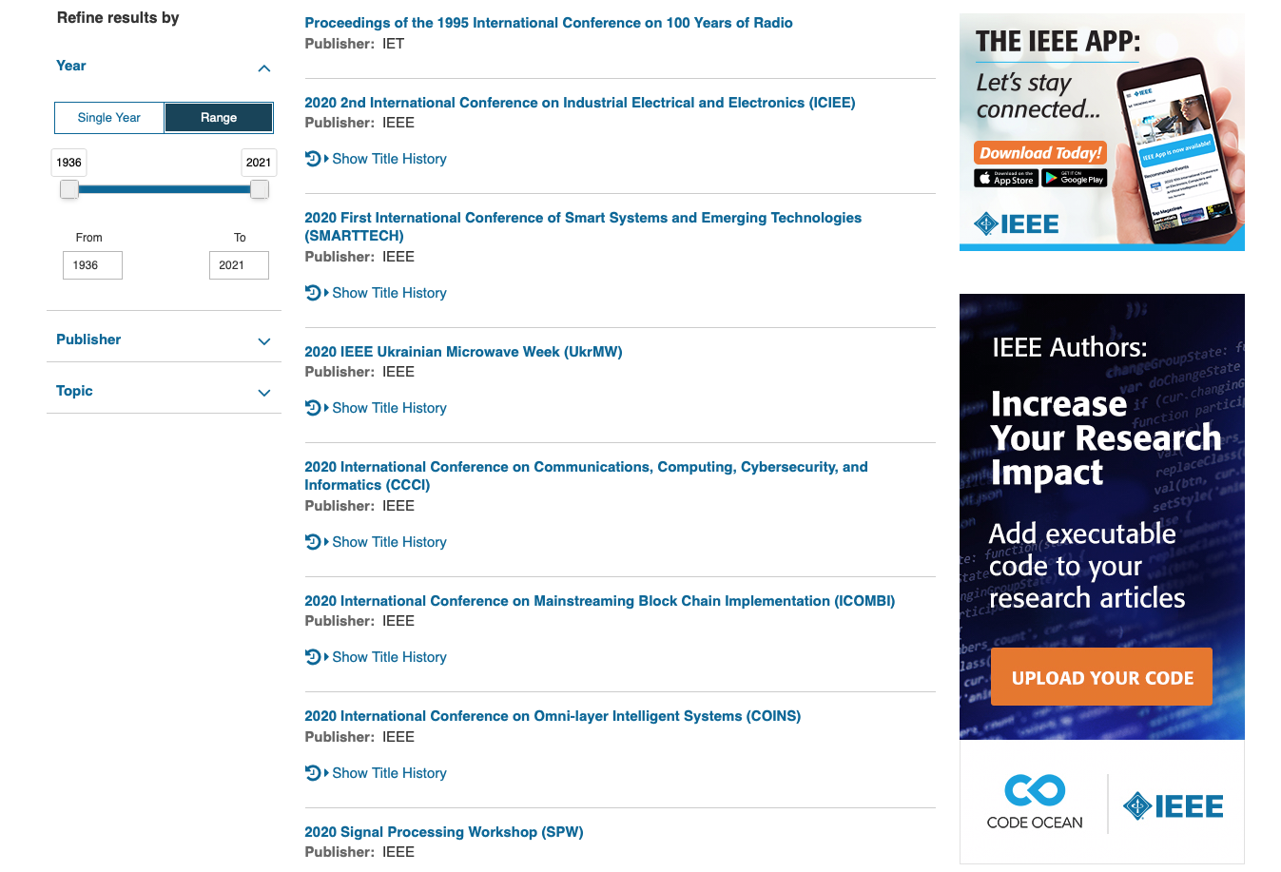
Increase impact of your results
Screen shot from
IEEE Explorer
today

Slide 51
Functionality stair
Automation engineer view
4
Industry wide automation ecosystem
3
Efficient automation management
2
Multi stakeholder secure automation
1
Selected automation systems easily connected
0 Prototype automation solution

Slide 52
Next step
Training - artefacts
Eclipse Arrowhead “Hello World” example
Utilising the ServiceRegistry
Utilising the Orchestration system
Utilising the Authorisation system
Building your own application
Using support core systems
Multiple local clouds
Security
Run-time engineering
Solution modelling and engineering

Slide 53
Comments! Questions?
jerker.delsing@ltu.se

